Slide 1




Advanced Tree Structures
Binary Trees, AVL Tree, Red-Black Tree, B-Trees, Heaps
Advanced Tree Structures
SoftUni Team
Technical Trainers
Software University
http://softuni.bg

Slide 2

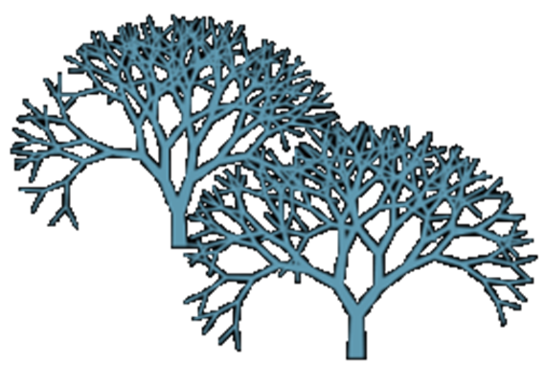
Table of Contents
Balanced Binary Search Trees
AVL-Tree, Red-Black Tree, AA-Tree
B-Trees
B-Tree, B+ Tree
Heaps
Binary Heap

Slide 3

Balanced Binary Trees
Binary Tree, AA-Tree, AVL-Tree, Rope

Slide 4
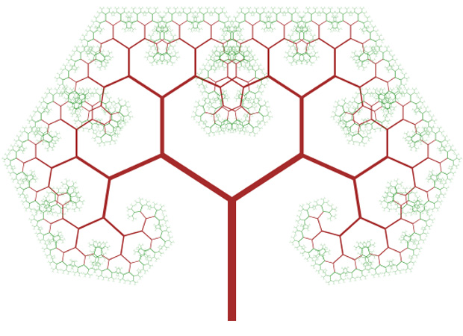
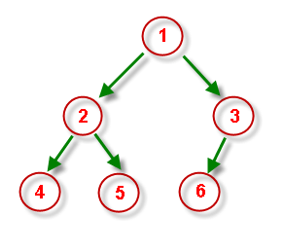
What is Binary Tree?
Binary tree is a tree data structure
Binary tree has a root node
Each node has at most two children
Left and right child
Binary search trees are ordered trees
Binary search trees can be balanced
Subtrees hold nearly equal number of nodes
Subtrees are with nearly the same height

Slide 5
Balanced Binary Search Tree – Example
The left subtree holds 7 nodes
33
The right subtree holds 6 nodes
The left subtree has height of 3
The right subtree has height of 3
18
54
15
24
42
60
3
17
20
29
37
43
85

Slide 6
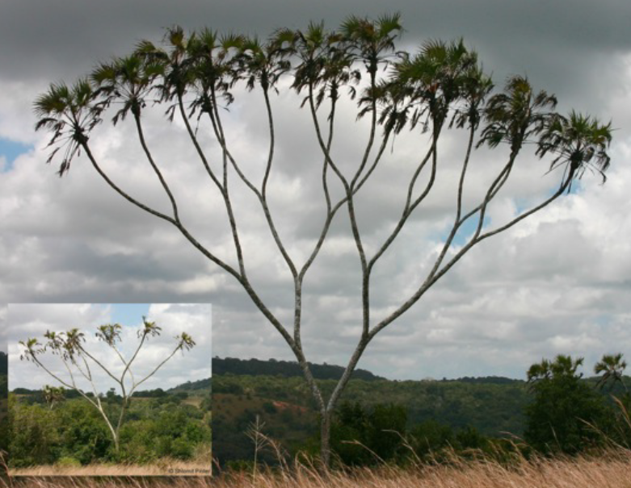
Binary Tree Implementation
Live Demo

Slide 7
Most Popular Binary Trees
Binary tree – tree with at most 2 children
Binary search tree – ordered binary tree
Balanced binary search trees
AA-tree – simple balanced search tree (fast add / find / delete)
AVL-tree – self-balancing binary search tree (very rigidly balanced)
Red-black tree – colored self-balancing binary search tree
Rope – balanced binary tree that preserves the order of elements
Provides fast access by index / add / edit / delete operations
Others – splay tree, treap, top tree, weight-balanced tree, …

Slide 8
AVL Tree
AVL tree is a self-balancing binary-search tree (visualization)
Named after Soviet inventors Adelson-Velskii and Landis
Height of two subtrees can differ by at most 1
17
 | Average | Worst case
Space | O(n) | O(n)
Search | O(log n) | O(log n)
Insert | O(log n) | O(log n)
Delete | O(log n) | O(log n)
9
25
6
12
20

Slide 9
AVL Tree Rebalancing
Balance is preserved with a balance factor (BF) in each node
BF of any node is in the range [-1, 1]
If BF becomes -2 or 2 → rebalance
Rebalancing is done by retracing
Start from inserted node's parent and go up to root
Perform rotations to restore balance
BF == left subtree height – right subtree height
0
-1
17
0
1
2
9
25
0
0
5
12
20
0
1
19

Slide 10
AVL Tree Rotations
Left-Right -> Left-Left Case
1. Left-Right
2. Left-Left
3. Balanced
5
5
4
D
D
3
4
3
5
A
C
A
B
C
D
4
3
B
C
A
B

Slide 11
AVL Tree Rotations
Right-Left -> Right-Right Case
1. Right-Left
2. Right-Right
3. Balanced
3
3
4
A
A
5
4
3
5
D
B
A
B
C
D
4
5
B
C
C
D

Slide 12
AVL Tree – Example
0
0
0
17
17
17
0
1
0
2
0
0
→
→
9
25
9
25
9
22
0
0
0
0
0
0
0
0
0
-1
5
12
20
5
12
19
5
12
19
25
22
0

Slide 13
AVL Tree Insertion Algorithm
Insert node N like in any ordinary BST
Begin retracing from N's parent P up to the root
Modify balance factors as you go up
If balance factor ∉ [-1,1] → rebalance
1
20
0
-1
12
25
0
0
0
8
17
26
0
0
0
0
4
10
15
19

Slide 14
Insertion - #1
Insert 11
1
20
0
-1
12
25
0
0
0
8
17
26
0
0
0
0
4
10
15
19

Slide 15
Insertion - #2
11 < → go left
20
1
20
0
-1
12
25
0
0
0
8
17
26
0
0
0
0
4
10
15
19

Slide 16
Insertion - #3
11 < → go left
12
1
20
0
-1
12
25
0
0
0
8
17
26
0
0
0
0
4
10
15
19

Slide 17
Insertion - #4
11 > → go right
8
1
20
0
-1
12
25
0
0
0
8
17
26
0
0
0
0
4
10
15
19

Slide 18
Insertion - #5
11 > → go right
10
1
20
0
-1
12
25
0
0
0
8
17
26
0
0
0
0
4
10
15
19

Slide 19
Insertion - #6
1
Right node is null → insert
Right subtree grows →reduce 's BF
Did the subtree starting from increase its height?
Yes → begin retracing
No → over
20
10
0
-1
12
25
0
0
0
10
8
17
26
0
-1
0
0
4
10
15
19
0
11

Slide 20
Retracing - #1
1
Node –
Parent –
BF - 1 because right subtree increased height
Go up
10
20
8
0
-1
12
25
-1
0
0
8
17
26
0
-1
0
0
4
10
15
19
0
11

Slide 21
Retracing - #2
1
Node –
Parent –
BF + 1 because left subtree increased height
Go up
8
20
12
1
-1
12
25
-1
0
0
8
17
26
0
-1
0
0
4
10
15
19
0
11

Slide 22
Retracing - #3
2
Node –
Parent –
BF + 1 because left subtree increased height
BF = 2 → rotate
Follow Left Left Case
12
20
20
1
-1
12
25
-1
0
0
8
17
26
0
-1
0
0
4
10
15
19
0
11

Slide 23
Left Left Rotation
2
Node –
Parent –
's right child becomes left child of
becomes right child of
12
20
20
1
-1
12
25
12
-1
0
0
20
8
17
26
20
12
0
-1
0
0
4
10
15
19
0
11

Slide 24
Left Left Rotation #2
0
Invalid Balance factor restored
→ Over
More: https://en.wikipedia.org/wiki/AVL_tree
12
-1
0
8
20
0
-1
0
-1
4
10
17
25
0
0
0
0
11
15
19
26

Slide 25
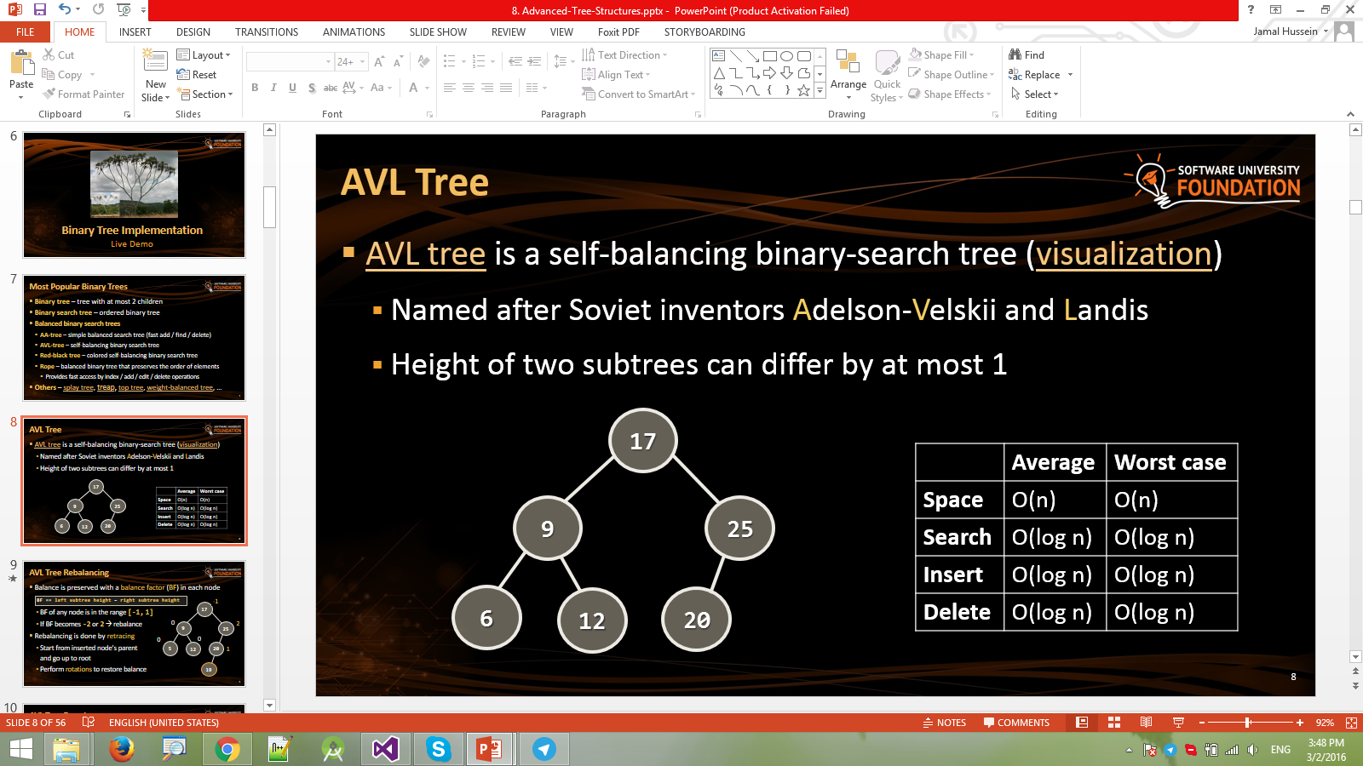
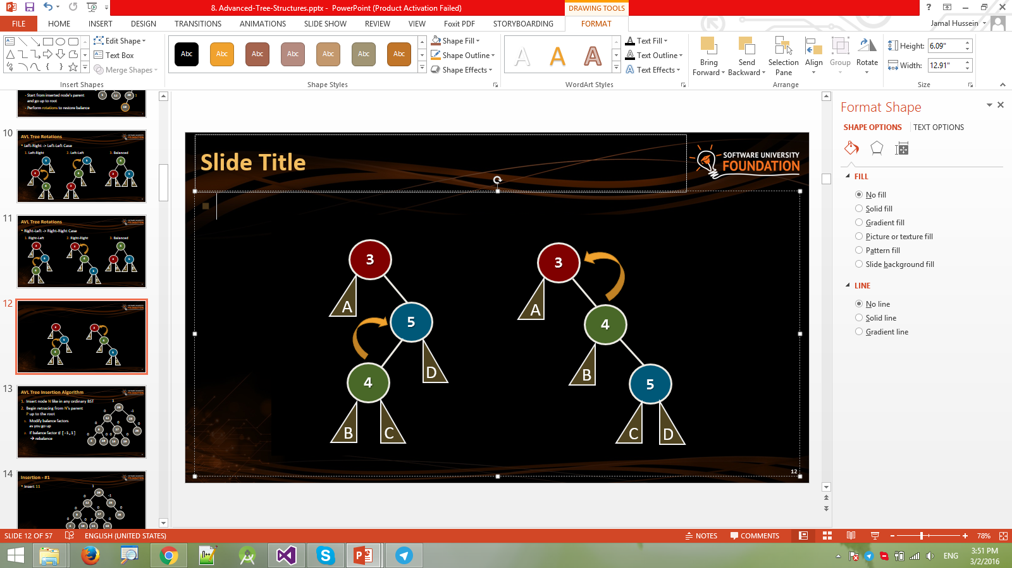
Lab Exercise
AVL Tree Implementation
(Insertion + Search)

Slide 26
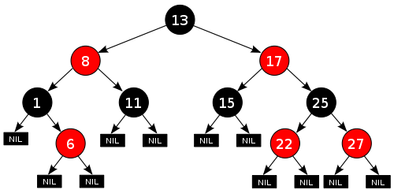
Red-Black Tree
Red-Black tree – binary search tree with red and black nodes
Not perfectly balanced, but has height of O(log n)
Used in C# and Java
See the visualization
AVL vs. Red-Black
AVL has faster search (it is better balanced)
Red-Black has faster insert / delete
Red-Black tree proof

Slide 27
Red-Black Tree Properties
13
A node is either red or black
The root is black
All leaves ( ) are black
If a node is red, then both its children are black
Every path from a given node to its descendant leaf nodes contains the same number of black nodes
E.g. All paths from have exactly 1 black node
8
17
1
11
15
25
NIL
NIL
6
NIL
NIL
NIL
NIL
22
27
NIL
NIL
NIL
NIL
NIL
NIL
13

Slide 28

Red-Black Tree Implementation
red
black
Live Demo

Slide 29
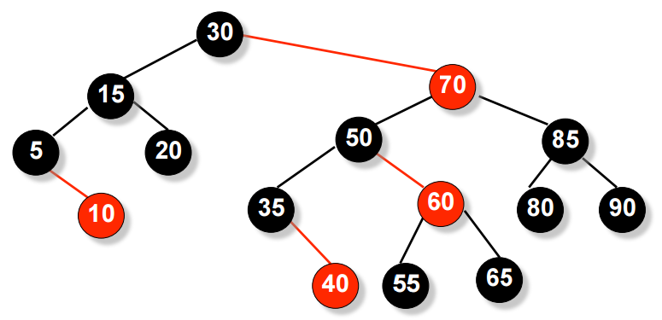
AA Tree
AA tree (Arne Andersson)
Simple self-balancing binary-search tree
Simplified Red-Black tree
Easier to implement than AVL and Red-Black
Some Red-Black rotations are not needed
Slower than AVL & RB

Slide 30
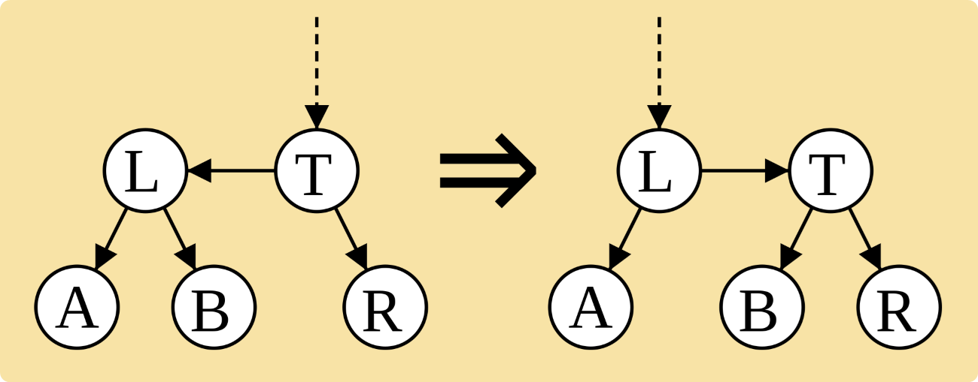
AA Tree Implementation
Live Demo

Slide 31
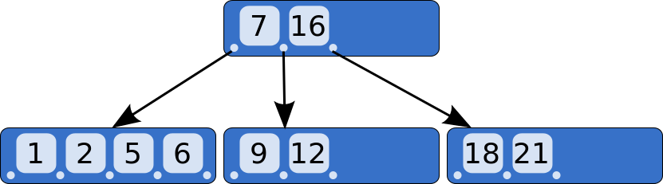
B-Trees
B-Tree, B+ Tree

Slide 32
What are B-Trees?
B-trees are generalization of the concept of ordered binary search trees – see the visualization
B-tree of order b has between b and 2*b keys in a node and between b+1 and 2*b+1 child nodes
The keys in each node are ordered increasingly
All keys in a child node have values between their left and right parent keys
If the B-tree is balanced, its search / insert / add operations take about log(n) steps
B-trees can be efficiently stored on the hard disk

Slide 33
B-Tree – Example
B-Tree of order 2 (also known as 2-3-4-tree):
17
21
7
11
18
20
26
31
4
5
6
8
9
12
16
22
23
25
27
29
30
32
35

Slide 34
B-Trees vs. Other Balanced Search Trees
B-Trees hold a range of child nodes, not single one
B-trees do not need re-balancing so frequently
Unlike other self-balancing search trees (like AVL, AA and Red-Black)
B-trees may waste some space (memory)
Since nodes are not entirely full
B-Trees are good for database indexes
Because a single node is stored in a single cluster of the hard drive
Minimize the number of disk operations (which are very slow)

Slide 35
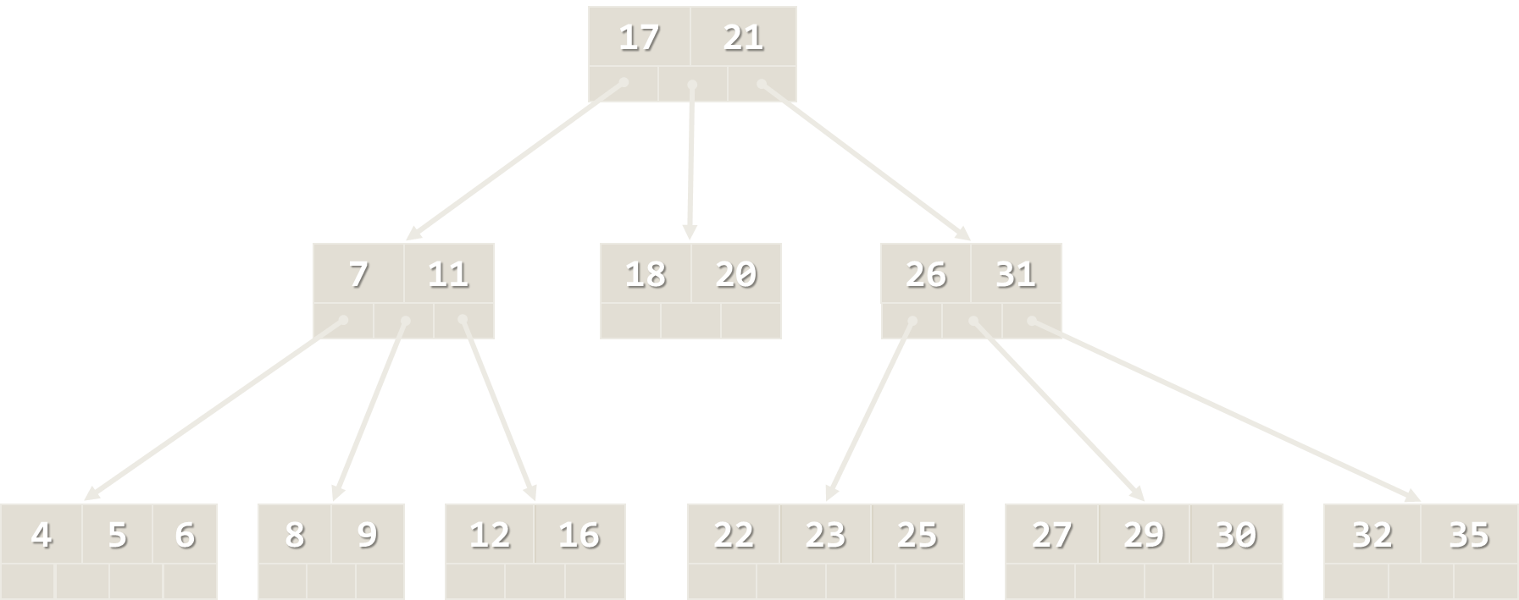
Implementation of B-Tree
Live Demo

Slide 36
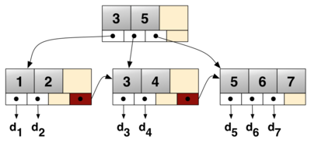
B+ Tree
B+ tree is a special kind of B-tree
Internal nodes hold keys + children + links
Leaf nodes hold keys only + links
Nodes at each level are linked in a doubly-linked list
B+ tree is used for storing data for efficient retrieval in block-oriented storage context, e.g. in file systems and databases
B+ tree has a lot of pointers to child nodes in a node
Reduces the number of I/O operations to find an element
Many file systems and RDBMS use B+ trees for efficiency

Slide 37
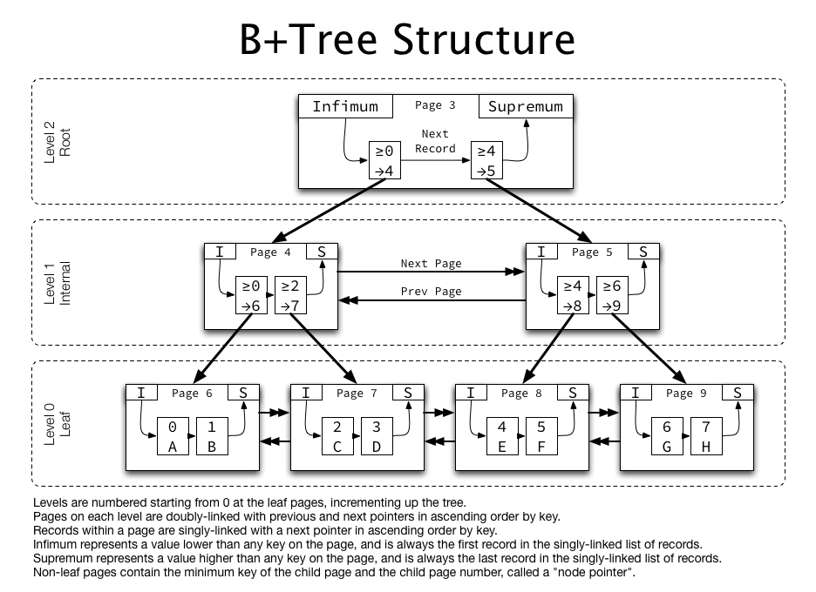
B+ Tree – Example

Slide 38
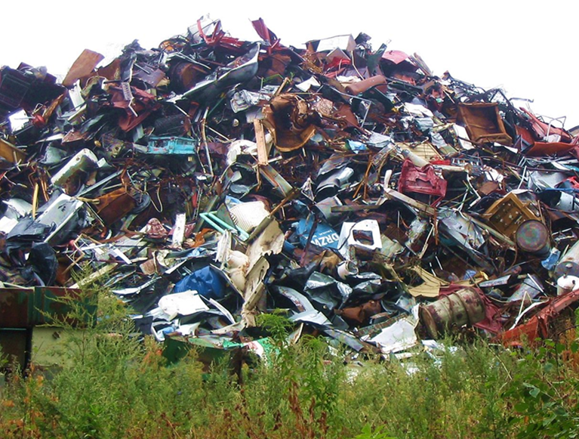
Priority Queue and Heaps
Heap, Binary Heap

Slide 39
Priority Queue
Priority queue in an abstract data type (ADT) that supports:
Insert-with-Priority(element, priority)
Pull-Highest-Priority-Element() → element
Peek-Highest-Priority-Element() → element
In C# and Java usually the priority is passed as comparator
E.g. IComparable<T> in C# and Comparable<T> in Java
Priority queue can be efficiently implemented as heap
Any balanced search tree could work as well (e.g. AVL)

Slide 40
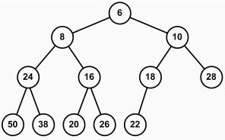
What is Heap?
Heap is a special type of balanced binary tree stored in array
Heap holds the "heap property": parent ≤ children
Each child node should be greater or smaller than its parent
Max Heap
The parent nodes are always greater or equal to the child nodes
Min Heap
The parent nodes are always less than or equal to the child nodes

Slide 41
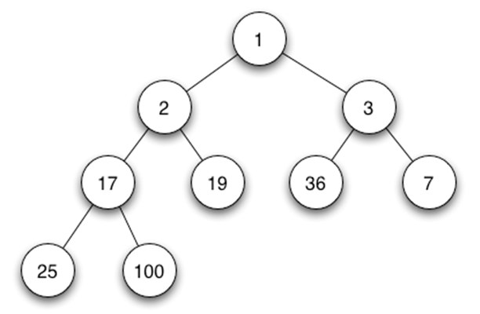
Binary Heap
Binary heap is a heap data structure representing a binary tree
Efficiently stored in a single array (no pointers at all)
Binary heap have two constraints:
Shape property: а binary heap is a complete binary tree
Heap property: all nodes are either greater than or equal to or less than or equal to each of its children
Binary heap efficiently implements a priority queue by binary tree stored as array

Slide 42
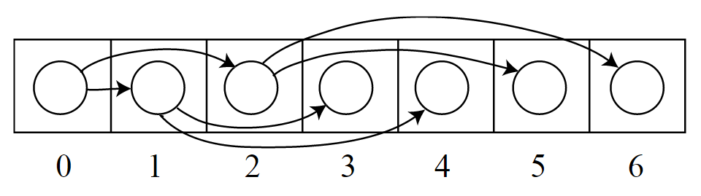
Binary Heap – Array Implementation
Binary heap can be efficiently stored in an array
Nodes 2*k and 2*k+1 have parent k
Operations:
Insert, Extract-Max, Build-Max-Heap
Heapify-Up, Heapify-Down

Slide 43
Binary Heap in Array: Tree Node Indexes
How to calculate the parent and children of given node i?
parent(i) = (i - 1) / 2
leftChild(i) = 2 * i + 1
rightChild(i) = 2 * i + 2

Slide 44
Binary Heap: Heapify-Down
Apply the "heap property" down from given node:
void Heapify-Down(heapArr, i)
left = leftChild(i); // 2*i + 1
right = rightChild(i); // 2*i + 2
largest = i;
if left < length(heapArr) && heapArr[left] > heapArr[largest]
largest = left;
if right < length(heapArr) && heapArr[right] > heapArr[largest]
largest = right;
if largest ≠ i
Swap(heapArr[i], heapArr[largest]);
Heapify-Down(largest);

Slide 45
Binary Heap: Heapify-Up
Apply the "heap property" up from given node:
Insert a new node:
void Heapify-Up(heapArr, i)
while hasParent(i) // i > 0
&& heapArr(i) > heapArr(parent(i)) // (i - 1) / 2
Swap(heapArr[i], heapArr[parent(i)]);
i = parent;
void Insert(heapArr, node)
heapArr.Append(node);
Heapify-Up(heapArr, lastElement(heapArr));

Slide 46
Binary Heap: Build-Max-Heap and Insert
Build a binary heap from array of elements:
Extract the max element from the heap:
void Build-Max-Heap(heapArr)
for i = length(heapArr) / 2 downto 1
Heapify-Down(heapArr, i)
void Extract-Max(heapArr)
max = heapArr[0];
heapArr[0] = delete last element from heapArr;
if length(heapArr) > 0
Heapify-Down(0);
return max;

Slide 47
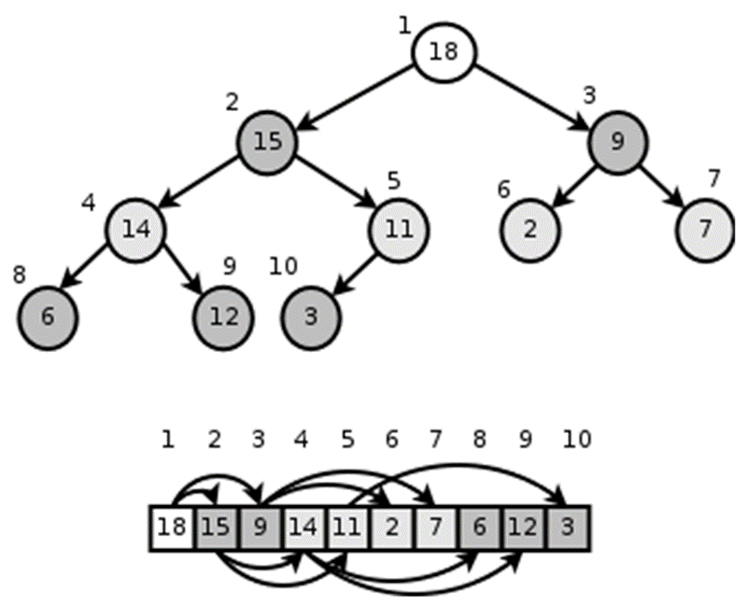
Implementing Binary Heap
Lab Exercise

Slide 48

Summary
Balanced binary search trees provide fast add / search / remove operations – O(log(n))
AVL trees are rigidly balanced BSTs
Fast search, slower add/remove
Red-Black trees are less balanced → slower search time
Provide faster add/remove
B-Trees are ordered trees that hold multiple keys in a single node
Heaps provide fast add / find-min / remove-min operations

Slide 49








Advanced Tree Structures
https://softuni.bg/trainings/1308/data-structures-february-2016

Slide 50
License
This course (slides, examples, labs, videos, homework, etc.) is licensed under the "Creative Commons Attribution-NonCommercial-ShareAlike 4.0 International" license
Attribution: this work may contain portions from
"Fundamentals of Computer Programming with C#" book by Svetlin Nakov & Co. under CC-BY-SA license
"Data Structures and Algorithms" course by Telerik Academy under CC-BY-NC-SA license

Slide 51






Free Trainings @ Software University
Software University Foundation – softuni.org
Software University – High-Quality Education, Profession and Job for Software Developers
softuni.bg
Software University @ Facebook
facebook.com/SoftwareUniversity
Software University @ YouTube
youtube.com/SoftwareUniversity
Software University Forums – forum.softuni.bg

